Slide 1
C++ Contracts A Meaningfully Viable Product
Andrei Zissu
Morphisec

Slide 2
C++ Contracts – a Meaningfully Viable Product
Andrei Zissu
Morphisec – preventive cybersecurity + anti-ransomware
WG21 member for the last 3 years
Active in SG21
Not one of the main authors of the Contracts proposal (P2900)

Slide 3
What This Talk Is About
A moderately deep dive into contracts in C++26
With some detail on considerations, controversies and paths not taken
I’ll strive to make the terminology easily accessible
Not always stick to the official terms
I’ll try not to focus on theory
But will sometimes present the important parts
Including relevant P2900 guiding principles, present in proper context
I will be borrowing heavily from P2900 (the C++ contracts proposal, previously known as the contracts MVP) and P2899 (the rationale paper)
Occasionally other papers will also be mentioned and possibly borrowed from
Not enough time to cover everything I would have wanted to

Slide 4
Some quick terminology

Slide 5
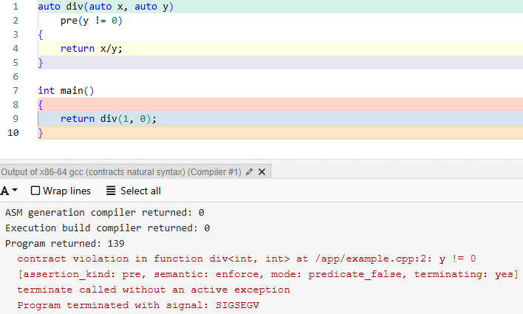
Precondition Specifiers
“Precondition” is a plain language term, while “precondition specifier” refers to a syntactic construct.

Slide 6
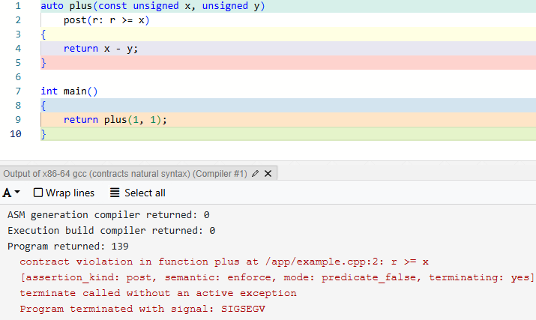
Postcondition Specifiers
The term “postcondition” is used in everyday language, whereas “postcondition specifier” denotes a specific syntactic element.
r is directly naming the function return value – we’ll cover this later
Also keep the const parameter in mind for later…

Slide 7
Function Contract Specifiers
The collective term for all pre and post specifiers (for preconditions and postconditions)
I will often refer to them simply as pre and post

Slide 8
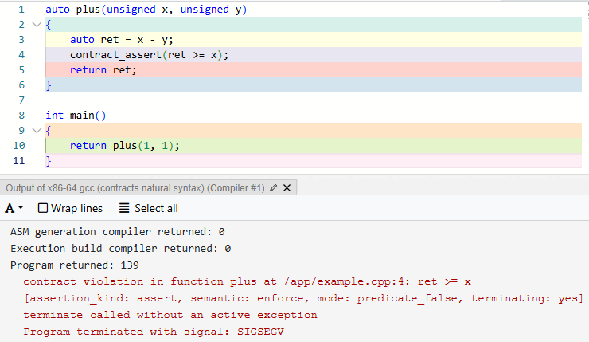
Assertion Statements (a.k.a contract_assert)

Slide 9
Contract Assertions
The collective term for the syntactic construct specified by function contract specifiers (pre and post) and assertion statements
Previously known as CCA (contract-checking annotation) - renamed due to incorrectness, since these are not actually annotations
Yes, this includes pre and post, while contract_assert is referred to only as “assertion statement”
For convenience I will be referring to them mostly in short as “CA” – short for “contract assertion” (which is a bit of a mouthful)

Slide 10
Contract Predicates
The C++ code inside a contract assertion
Must be contextually convertible to bool
We can usually mix and match the terms “contract assertion” and “contract predicate”
But occasionally they do have important distinguishing differences
Like ignore semantics

Slide 11
Some Bikeshedding History (or whatever you choose to name it)

Slide 12
Contract Assertions
Started off as CCA (Contract-Checking Annotation)
Renamed since some committee members didn’t think the term “annotations” is appropriate
Still being informally used (myself included)
Also proposed: CAA (Contract-Assertion Annotation) - didn’t catch on
I proposed "contract clauses”

Slide 13
contract_assert
Other languages use “assert”
But that would conflict with the existing C assert macro
So pending a future solution, we needed another name
Over 40 alternatives were collected and explored in P2961R2 - A natural syntax for Contracts

Slide 14

Bikeshedding – 1st Wheel
contractassert
mustexpr
dyn_assert
musthold
asrtexpr
stdassert
truexpr
co_assert
ccassert
contract_assert
std_assert
dyn_check
mustbetrue
assertexpr
assertion_check
cppassert
dynamic_assert
cca_assert
assrt
runtime_assert
_Assert
xpct
assert_check
Assert2

Slide 15

Bikeshedding – 2nd Wheel
cpp_assert
affirm
__assert
assess
insist
asrt
cassert
aver
posit
enforce
audit
claim
ass
must
confirm
assertion
ensure
chk
verify
expect
check

Slide 16
Finalists - contract_assert and assertexpr
contract_assert won the day
I voted against assertexpr as it resembles constexpr, which is used only in declarations
Given that contract_assert is currently a statement and not an expression (see later) I’m particularly glad we chose this name

Slide 17
Syntactic restrictions, and how they came to be

Slide 18

Multiple Declarations – because we love IFNDR!
(Function) contract specifiers (pre/post) must always be declared on function first-declarations
First declaration - “a function from which no other declaration is reachable”
i.e. 1st declaration found by compiler in current TU (a.k.a .cpp file)
Otherwise it’s a “redeclaration”
That includes function body when defined separately from first declaration
Used but not defined by the standard – until P2900 that is
Contracts repetition in function redeclarations is allowed (not mandatory, since compilers don’t need them) for several reasons:
User friendliness
Functions declared in multiple headers – we wouldn’t want include order to matter (never feed the include hell trolls!)
Friend declarations may be instantiated in any order
This Photo by Unknown Author is licensed under CC BY

Slide 19
Multiple Declarations – because we love IFNDR!
Ill-formed if repeated contract specifiers differ from reachable first declaration
Equivalence is determined by token equality (same as ODR)
But allows for different names for function and template parameters
As long as the contract specifications do refer to the same entities
Note: parameter names are not in the type system, therefore in function declarations they have no actual meaning (same as const by value params – which we’ll also encounter later)
Redeclarations in same TU cannot contain lambdas - would automatically render them “not the same” due to different type for each lambda

Slide 20
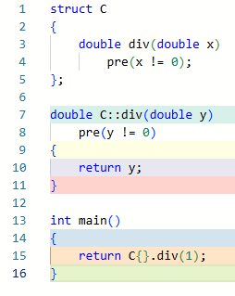
Multiple Declarations – because we love IFNDR!
Well-formed renaming:

Slide 21
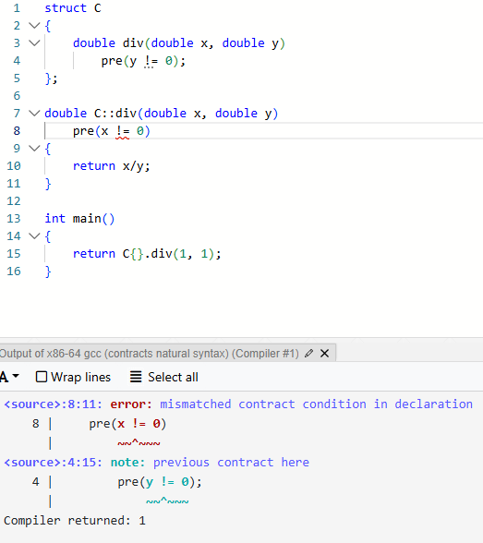
Multiple Declarations – because we love IFNDR!
Ill-formed renaming:

Slide 22
Semantics

Slide 23
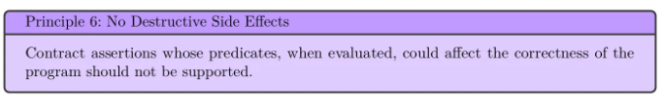
Constification – our favorite bowel non-movement
Officially called “implicit const-ness”
Often auto-corrected to “constipation”
Main motivation:
Catch bugs like “assert(my_map[“universal_answer”] == 42)”
Avoid contracts producing side effects, whether inadvertently or intentionally
Not entirely clear cut - e.g. can the mere extra clock cycles affect program correctness?

Slide 24
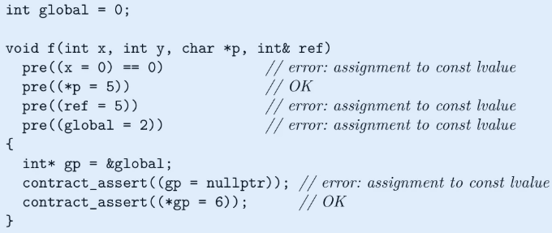
Constification – our favorite bowel non-movement
Effect:
External entities referenced by CAs are treated similarly to data members in const member functions
decltype still reports the original constness - same as in const member functions
But decltype((x)) yields const T& rather than just T&
Implicit const is shallow
Objects pointed to by pointers are not constified
Objects referred to by reference are constified
Globals were originally not included in constification – this was changed later to improve teachability

Slide 25
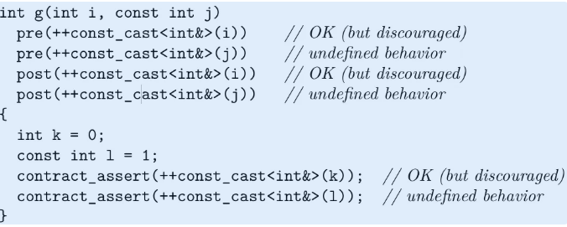
Constification – our favorite bowel non-movement
Controversial opt out - const_cast
Must be used with utmost care, as the outcome is UB if the object is originally const

Slide 26
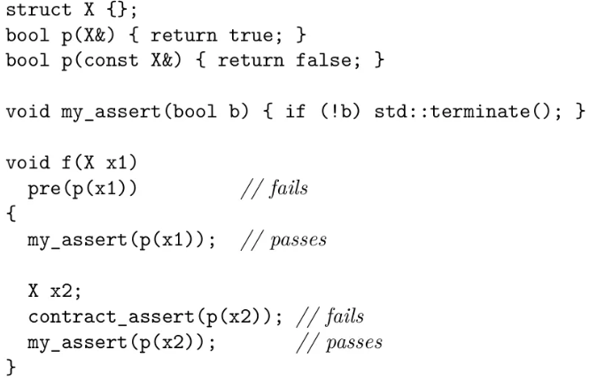
Constification – our favorite bowel non-movement
Objections:
Modifies overload resolution, therefore contracts may actually be evaluating different code

Slide 27
Constification – our favorite bowel non-movement
Objections:
Modifies overload resolution, therefore contracts may actually be evaluating different code
Counter - such overloads are bugs on their own
Counter counter (also given in other cases) - contracts must be useful with real world code, not educate programmers
Counter counter counter - contracts should indeed also encourage correct programming practices
Counter - side effects in contracts create a different program – rendering such contracts potentially meaningless/harmful
Counter - may help discover latent side effects in existing assert statements

Slide 28
Constification – our favorite bowel non-movement
Objections:
Shallow const
Constification is incomplete and inconsistent
In particular, pointers and references are inconsistent with each other
Counter - pointer/reference inconsistency is an existing language feature
not sure I buy into this when viewed from a contracts perspective
Counter - automatic deep const would be very complex to specify and implement

Slide 29
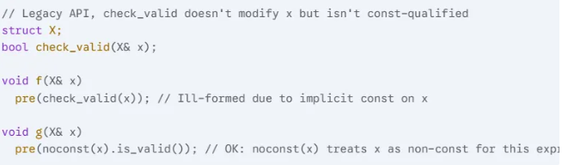
Constification – our favorite bowel non-movement
Objections:
Constification blocks some common non-const usages, such as logging and std::map::operator[]
Counter - blocking std::map::operator[] is actually a good thing, as it can indeed modify the map; std::map::at() can be used instead
Not so with things like logging though
Counter - const_cast as a controversial escape hatch
Other proposed escape hatches: mutable (applied to CA), operator noconst (applied to expression in CA)

Slide 30
Postconditions

Slide 31
Postconditions- Referring to the Result Object – what is a name?
Post may specify a name for the return value, valid only within the post itself
Works even when the function returns an unnamed temporary - no other way in the language to do this for all objects
Although it is feasible for user-provided constructors, but only where those are available
That name will capture the result object “on the fly”

Slide 32
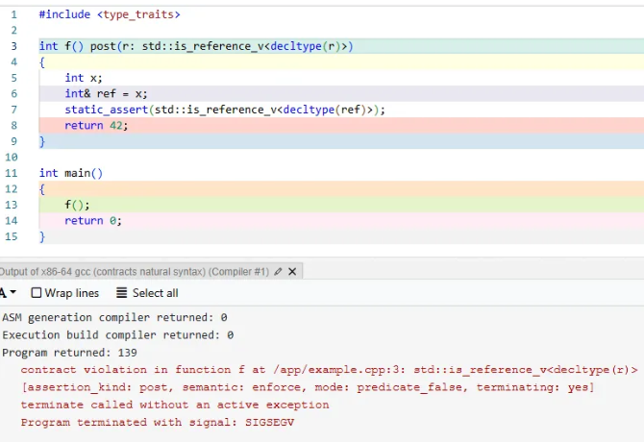
Postconditions - Referring to the Result Object – what is a name?
Similar to references but not really one, also compared to structured bindings
Main difference is that decltype doesn’t see it as a reference

Slide 33
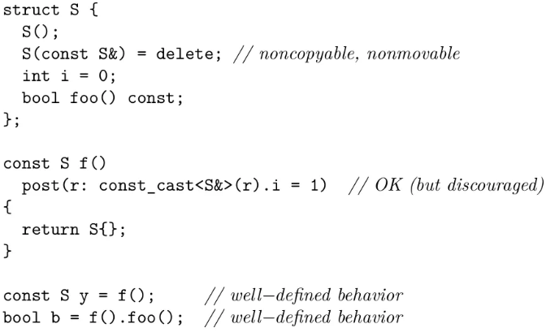
Postconditions- Referring to the Result Object – what is a name?
const_cast, although discouraged, is actually safe in this case - result object being captured on the fly is not yet assigned to the call site target variable, therefore it cannot yet be const

Slide 34
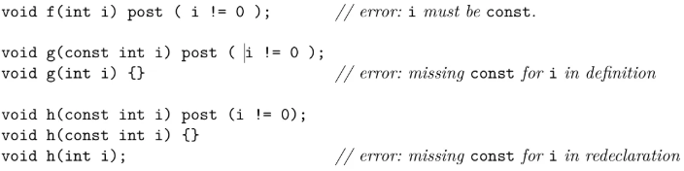
Referring to Parameters in Postconditions – wait, isn’t const meaningless when passing by value?
TLDR: by-value function parameters which are ODR-used (a.k.a accessed) in a post CA - must be const, in all the function declarations

Slide 35
Referring to Parameters in Postconditions – wait, isn’t const meaningless when passing by value?
Motivation (also in P2521 - 3.13):
CAs “capture” by reference
Post CAs are intended to work on initial parameter values
Contracts are impossible to reason about if based on mutating parameters
Must be consistent – thus program must be ill-formed if const is not applied to by-value parameters in all the function declarations
const on by-value parameters is still not part of the type system
Code is only ill-formed in the absence of const if ODR-used in a post CA
With future contract capture clauses (not in C++26) function parameters won’t have to be const – since intent will be explicit

Slide 36
Evaluation and Contract-Violation Handling

Slide 37
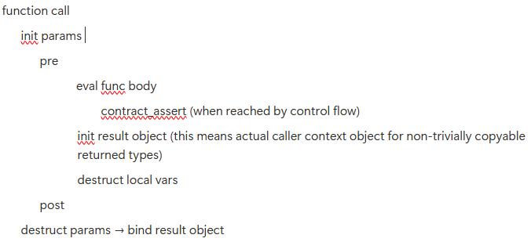
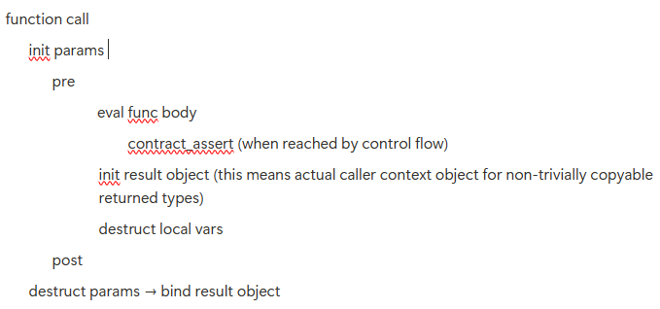
Point of Evaluation – who said it’s a single point?
Pre/post see function parameters (or possibly their register copies) but not local variables
Result object is initialized before post (thus post can see it), but is not yet considered bound
Caller context const (if present) doesn’t apply yet (meaning const_cast of result object in post is safe from UB)
Post is only evaluated on normal exit
Evaluation when exiting due to exception may be possible in the future
Post is evaluated only after local variables destruction - since those might influence what post is checking

Slide 38
Evaluation Semantics and selection thereof – because nothing is pre-ordained
Checking semantics
Observe
Terminating semantics
Enforce
Quick_enforce (was “Louis semantic”)
Ignore semantic
Unlike C assert, it ODR-uses and must be well-formed

Slide 39
Evaluation Semantics and selection thereof – because nothing is pre-ordained
Upon violation
At run time
Observe
Invoke violation handler
Continue execution (upon normal return)
Enforce
Invoke violation handler
Terminate (upon normal return from violation handler)
Quick_enforce
Terminate immediately
At compile time
Observe – issue diagnostic (a.k.a warning)
Enforce and quick_enforce – make program ill-formed
Ignore – doing nothing in both cases

Slide 40
Evaluation Semantics and selection thereof – because nothing is pre-ordained
Selection of contract semantics is implementation-defined
Because different implementations have different needs
No specification of when this happens
Any build stage
Run time
Allowing dynamic contracts configuration
Build modes (e.g. debug and release) are no longer required for this
But of course are still allowed
Different semantics may be selected for different CAs in the same TU
Or even for the same CA at different evaluations!

Slide 41
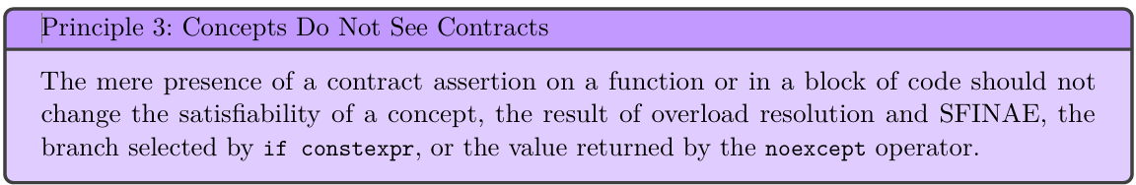
Evaluation Semantics and selection thereof – because nothing is pre-ordained
Implementations may offer any non-empty subset of the 4 semantics
Meaning that ignore semantic alone is compliant, which entails:
Enforcing CAs being well-formed
ODR-use
Side effects possible, e.g. initializing static data members of class templates
Chosen semantic explicitly undetectable from code at compile time
To avoid contracts changing observed behavior

Slide 42
Elision and Duplication - I swear to perhaps check the truth, and check it again and again and again, so help me the semantic
Any CA may be evaluated 0…N times
Possibly with different semantics each time
Repetition is required for supporting different caller and callee contract semantics
Likely to affect mainly pre and post
Up to 2 evaluations should normally suffice,
Other than multiple repetitions to test for unwanted CA side effects
Implementation requirements
Define an upper bound for repetition
Implementation recommendations
Allow users to configure any number of repetitions
Make the default one single evaluation without repetitions

Slide 43
Elision and Duplication - I swear to perhaps check the truth, and check it again and again and again, so help me the semantic
Elision can only happen if the compiler can prove that the predicate:
Returns true – typically if any of the following holds:
It’s evaluated at compile time
It’s guaranteed by previous CAs (in checked terminating semantics) contract_assert(x>1); contract_assert(x>0);
Cannot throw, longjmp or terminate

Slide 44
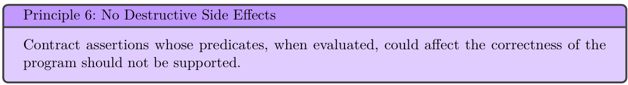
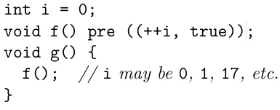
Elision and Duplication - I swear to perhaps check the truth, and check it again and again and again, so help me the semantic
With elision the compiler may also generate an equivalent expression
Which is only required to cover the well-defined cases
UB in original predicate is fair game
Existing side effects may be ditched in the process,
No new side effects may be introduced

Slide 45
Elision and Duplication - I swear to perhaps check the truth, and check it again and again and again, so help me the semantic
Elision is all or nothing - either all side effects of a CA are ditched or none at all
Take away: better not have side effects in CAs
Or at least don’t depend on them for business logic
CAs greatly benefit from no side effects
As-if rule - multiple successful evaluations are undistinguishable from a single one
Number of evaluations may still affect total execution time
Is that observable behavior? – depends on context

Slide 46
The Contract-Violation Handler – you can’t avoid termination (or can you?)
Definition:
A function named ::handle_contract_violation
Single argument of type const std::contracts::contract_violation&
Returns void
May be noexcept (but definitely doesn’t have to be)

Slide 47
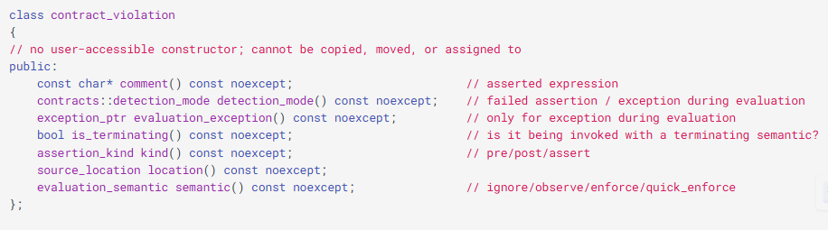
The Contract-Violation Handler – you can’t avoid termination (or can you?)

Slide 48
The Contract-Violation Handler – you can’t avoid termination (or can you?)
Properties:
Implementations must provide default handlers
Recommended to output the contract_violation info and to be noexcept
Default handler cannot be directly called by user code
But it can be called indirectly, via std::contracts::invoke_default_contract_violation_handler
But only from custom violation handlers, since users have no way of creating contract_violation objects

Slide 49
The Contract-Violation Handler – you can’t avoid termination (or can you?)
The Contract-Violation Handler – you can’t avoid termination (or can you?)
Properties:
Implementations may allow the handler to be replaceable
Replacement entails providing a same-name-and-signature function (inc. return type)
For normal functions this would result in linker errors (ambiguous symbol)
P2900 only mandates IFNDR if the handler is not replaceable
May have a different throwing specification than the default handler
Hence the standard library provides only an implementation but not an includable declaration of the default handler
Same as global operators new and delete
Some may consider that an unacceptable security risk – that’s ok

Slide 50
The Contract-Violation Handler – you can’t avoid termination (or can you?)
The Contract-Violation Handler – you can’t avoid termination (or can you?)
Rationale:
Libraries control what contracts they contain
Application controls how contracts are handled
With the custom handler instrumental in their toolbox
Installed at link time , because:
Different TUs and libs may be compiled at different times and with different toolchains
Too risky security-wise at run time
Replacing the handler doesn’t require recompiling the whole application (and libraries)
Contracts would be dead on arrival otherwise

Slide 51
The Contract-Violation Handler – you can’t avoid termination (or can you?)
The Contract-Violation Handler – you can’t avoid termination (or can you?)
contract_violation object requirements:
May reside anywhere other than the heap
Is produced in an unspecified manner (i.e. determined by the implementation)
Must be alive while the violation handler is executing
And so must any objects accessible through it (such as the comment string)
Side note: comment is expected to contain violating source code - which I insisted on being configurable (for security reasons) in a paper (P2947R0) which was rejected back in Tokyo

Slide 52
Throwing Violation Handlers and noexcept(contract_assert(false)) – Are you calling me a liar?
Contract violation handlers can do anything
Including throw or longjmp instead of returning normally
Throw and longjmp can circumvent enforce semantic - and that’s a feature, not a bug!
That’s actually an intentional backdoor in P2900
Throwing violation handlers were introduced in view of systems which can’t afford termination
After Bjarne brought this up in P2698R0
Likely buggy code following a failed CA will probably crash anyway
Actually not necessarily a backdoor
The main guarantee of enforce can be viewed as not allowing execution of the immediately following code

Slide 53
Throwing Violation Handlers and contract_assert(false) – are you calling me a liar?
Compiler must assume any CA might throw (if throwing violation handlers are supported)
Since throwing specification is only known at link time
Code bases might want to avoid making narrow-contract functions noexcept
Since one day their CAs might throw
And also to allow failure-based unitesting relying on exceptions
Also known as the Lakos Rule
I’ve personally been recommending only placing noexcept on cleanups and moves
Including functions reasonably expected to be on such a path
But I’m nowadays open to considering trivial getters/setters too

Slide 54
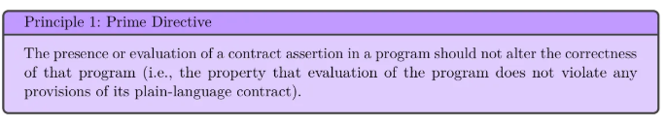

Throwing Violation Handlers and contract_assert(false) – are you calling me a liar?
What does noexcept(contract_assert(false)) return?
Having contracts alter an exception specification would violate the prime directive
But a previously non-throwing function/expression may now be throwing
Depending on whether the installed violation handler is noexcept, which is unknown at compile time
For which reason the mentioned expression must be assumed to be true (on platforms supporting throwing violation handlers)

Slide 55

Throwing Violation Handlers and contract_assert(false) – are you calling me a liar?
Rock and hard place:
Tell the truth and violate the prime directive
Or lie and be damned for all eternity
And we did fight over this almost for all eternity… ∞
And as in other similar cases we chose to avoid the land mine altogether
Although this time not by making it ill-formed

Slide 56
Throwing Violation Handlers and contract_assert(false) – are you calling me a liar?
Throwing Violation Handlers and contract_assert(false) – are you calling me a liar?
Rock and hard place:
But rather with a little cheating
We made contract_assert a statement rather than an expression
Well, I lied a bit too - this does make noexcept(contract_assert(false)) indirectly ill-formed
It also restricts contract_assert somewhat – vs C assert which can also act as a sub-expression
Which immediately-invoked lambdas help mitigate
Instead of this:
const int j = (contract_assert(i > 0), i);
You can write this:
const int j = ([i]{ contract_assert(i > 0); }(), i);
Which works since this works:
const int j = (void{}, i);

Slide 57
Final Word
Contracts are complicated
As is C++
Which is why it took so long to have them delivered
But you won’t normally care about all these details
Like about most other C++ details
But you can leverage them when necessary
You already know what I’m going to say here…
At the end of the day, contracts are a great tool
Like C++, you know the drill…

Slide 58
Final Word
Many thanks to the many contributors who made Contracts finally happen in C++26!
And special thanks to my reviewers: Timur Doumler and Joshua Berne
Which sent me so many comments that any remaining mistakes are definitely mine

Slide 59
Thank You!
Let’s get in touch!
andrziss@gmail.com
https://www.linkedin.com/in/andreizissu/
Questions?

